Slide 2
mega
giga
bytes
tera
peta
Notes:
Data has gotten bigger. Massive. Only just acquired the computing power to handle it.

Slide 3
quan·ti·fy
kwäntə fī
the act of counting and measuring human observations and experiences into numbers
Notes:
Take a myrad of information across many people and summarize them into decision-making figures.

Slide 8
1:1000
1:100
1:10

Slide 9
0 , 1

Slide 11
qual·i·ty
kwäl-lə-tē
how good or bad something is

Slide 12
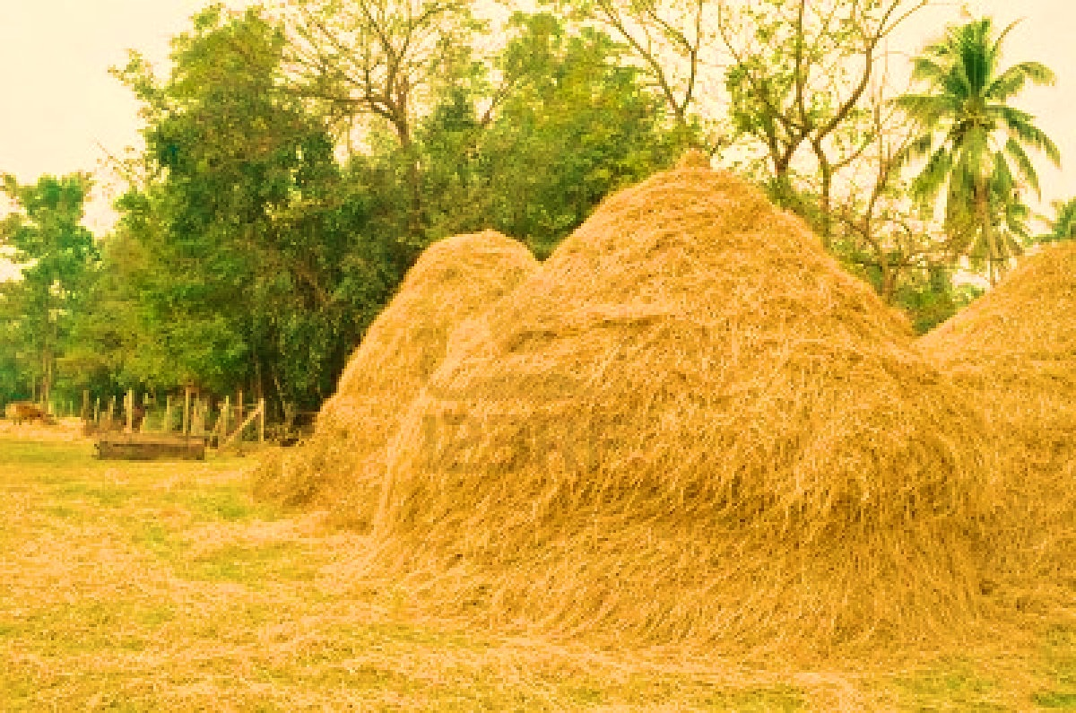
Notes:
Mountain of data. Overwhelm consumers with feedback, charts. If one haystack of information wasn’t compelling, neither will 10 haystacks.

Slide 13
Notes:
Examine which data elements are meaningful? Do we have a chance theory to support these data? Are we dealing with spurious information?

Slide 14
Notes:
Are we boxing consumers in to self-fulfilling loops? We target them based on past actions of others, we give them increasingly narrow offerings, they act on those offerings, we target them based on these behaviors. Periodic tests before we hit diminishing returns. We need to “open” the machine-learning loop. Scan the horizons, assess our own knowledge, experiment in field again.

Slide 15
mean·ing
ˈmē-niŋ
What is expressed, communicated, or conveyed and what can be inferred from context

Slide 18
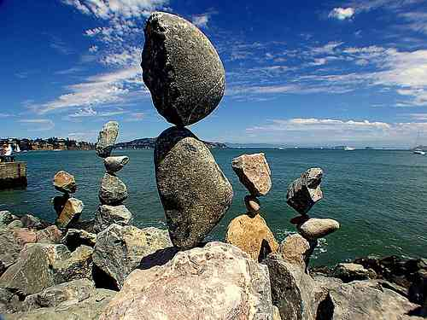

Slide 19
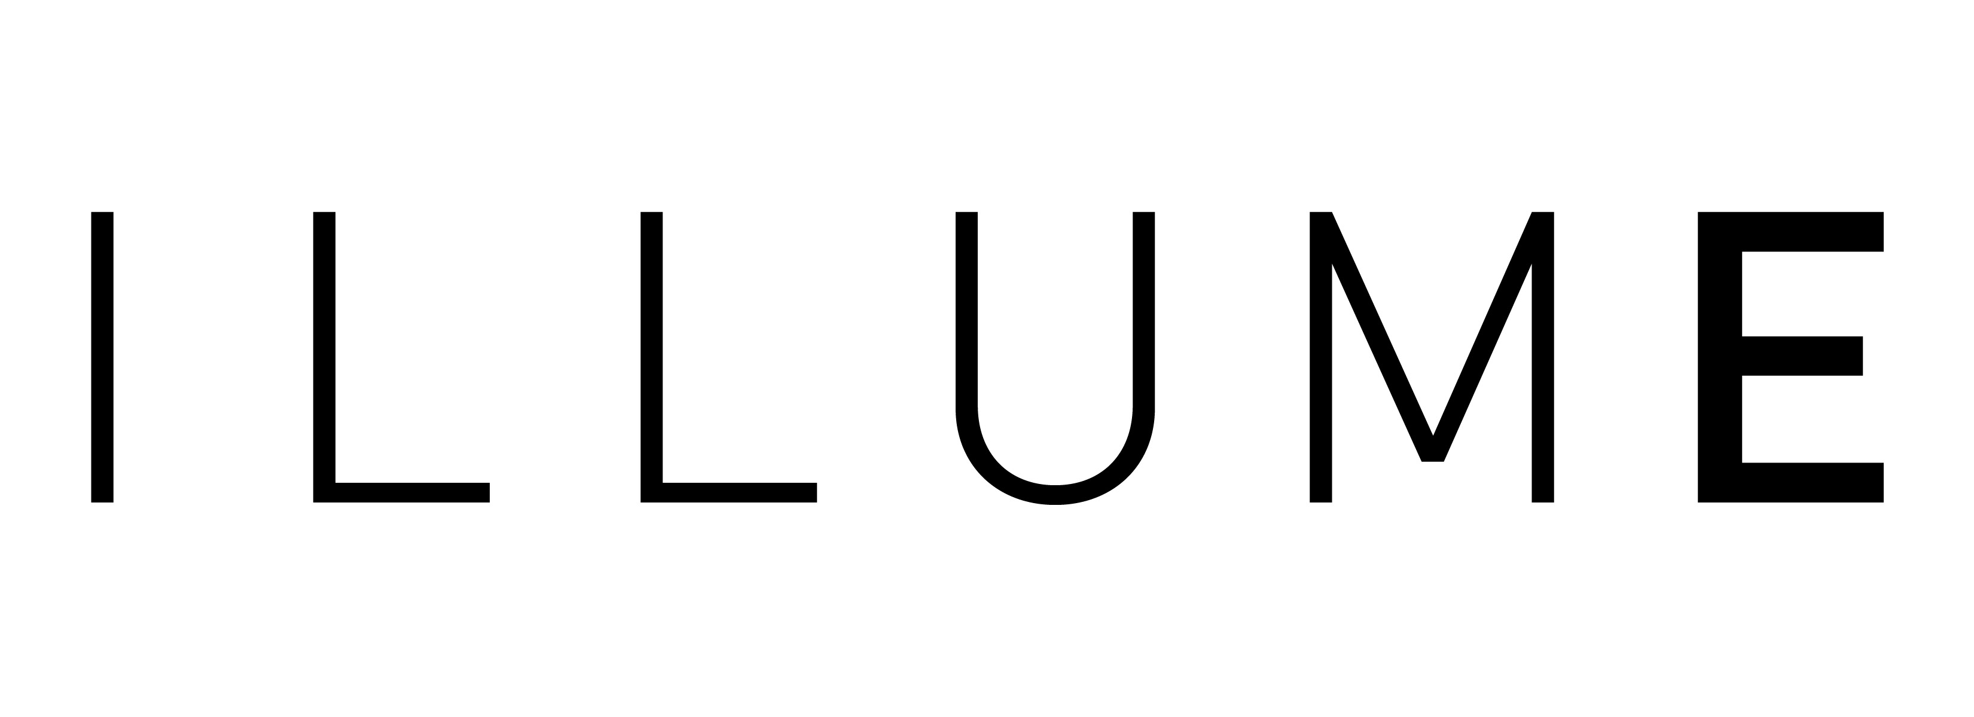
Anne E Dougherty, Founding Advisor
m: 608 561 2019
e: anne@illumeadvising.com
Anne Illume
@anneillume

